Slide 1
The Battle of Neighborhoods Presentation
Determine best restaurants offering Italian cuisine in Manhattan, New York and recommend choices to client

Slide 2
Problem
ABC Company located in Manhattan, New York is planning to host a company lunch for its employees to celebrate its success in landing a huge business contract. For this purpose, it wants to choose a restaurant offering Italian cuisine in Manhattan, New York
Find an Italian restaurant in Manhattan, New York with highest number of likes by customers so that its employees will really have an excellent dining experience and awesome food.

Slide 3
Interest
This project helps ABC Company in determining best Italian Restaurant venue in Manhattan, New York.
Anyone interested in finding any popular category of venue in any geographic location may be interested in this project by modifying search criteria.

Slide 4
Data Sources
Dataset containing geographical coordinates of New York neighborhoods is retrieved from scrapping web https://geo.nyu.edu/catalog/nyu_2451_34572.
Used Foursquare API to get the venues using the search criteria 'Italian" for the Manhattan latitude and longitude and transformed it into Pandas dataframe
Used Foursquare API to retrieve venue details relating to 'likes' 'count' for each venue and added this data point as 'likes count' column to
venues dataset. The ‘likes count’ used for determining the top 3
restaurant choices and offering preferred choice to solve the problem

Slide 5
Methodology
Used pandas libray to hold data, clean, explore and analyze dataset
Used numpy libray to handle data in a vectorized manner
Used geopy, folium libraries to create maps of New York and Manhattan neighborhoods, restaurant venues superimposed on top
Used Foursquare API to retrieve search and explore venues categorized as Italian Restaurant.
Venue ‘likes’ count and ‘rating’ data retrieved from Foursquare API
relied up on for recommending restaurant venues to the client
Run K-means clustering algorithm to group venues .
Plotted bar graph showing the top 5 restaurant venues and likes count

Slide 6
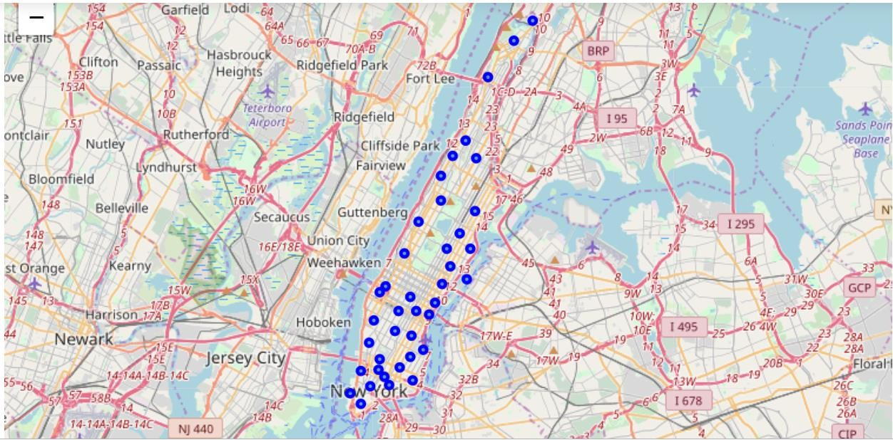
Map of Manhattan with 40 neighborhoods superimposed on top

Slide 7
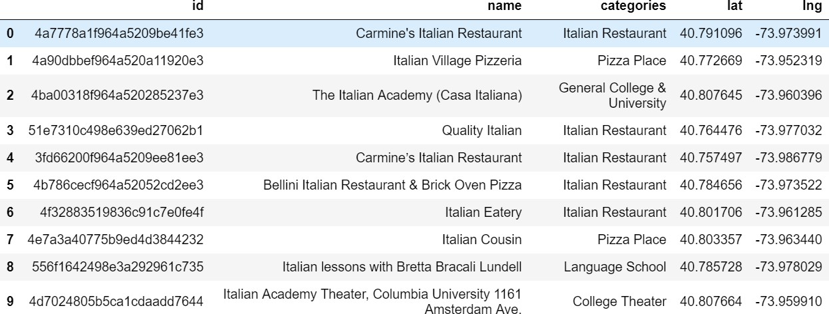
50 Venues data set retrieved using search criteria ‘Italian’ for Manhattan geographic
coordinates from Foursquare API
Here’re the first 10 rows of Venues dataset

Slide 8
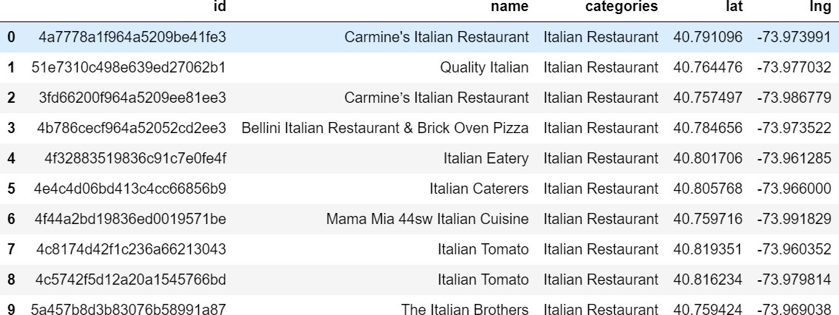
Venues dataset created from the results returned by Foursquare API contained venues other than restaurants. After cleaning, the venues dataset has 20 rows. Here’re the first 10 rows

Slide 9
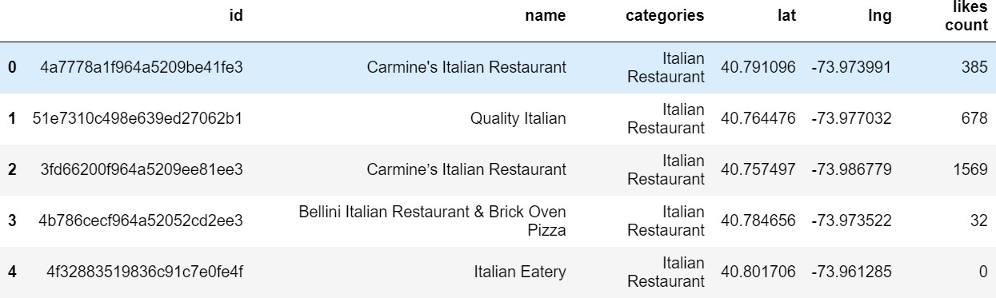
Used Foursquare API to retrieve venue details relating to 'likes' 'count' for each venue and added this data point as 'likes count' column to venues dataset. First 5 rows of the venues dataset after adding the ‘likes count’

Slide 10
Categorized venues based on 'likes count' by adding computed ‘grade’ column to
venues dataset.
Likes Count
<=50
51 - 100
101 – 200
201 – 300
>300
Grade poor average good great awesome

Slide 11
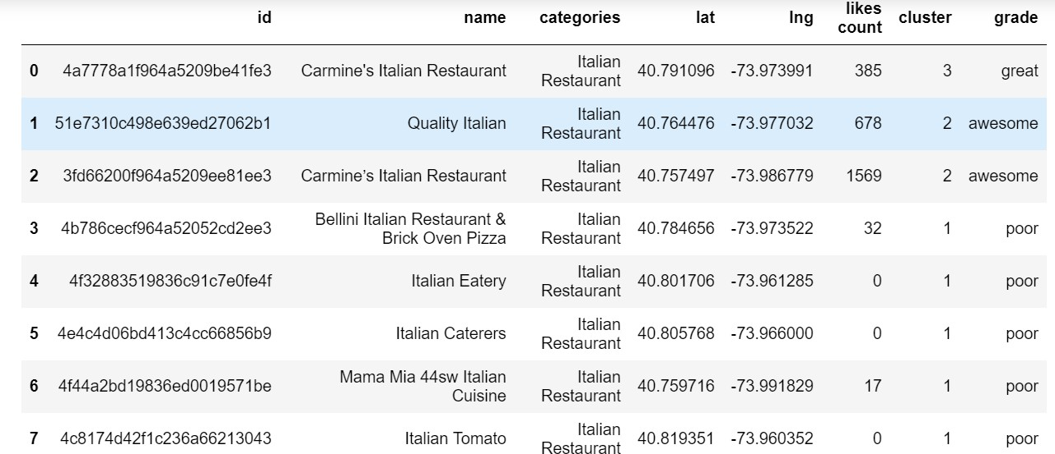
First 8 rows of venues dataframe after adding the grade column

Slide 12
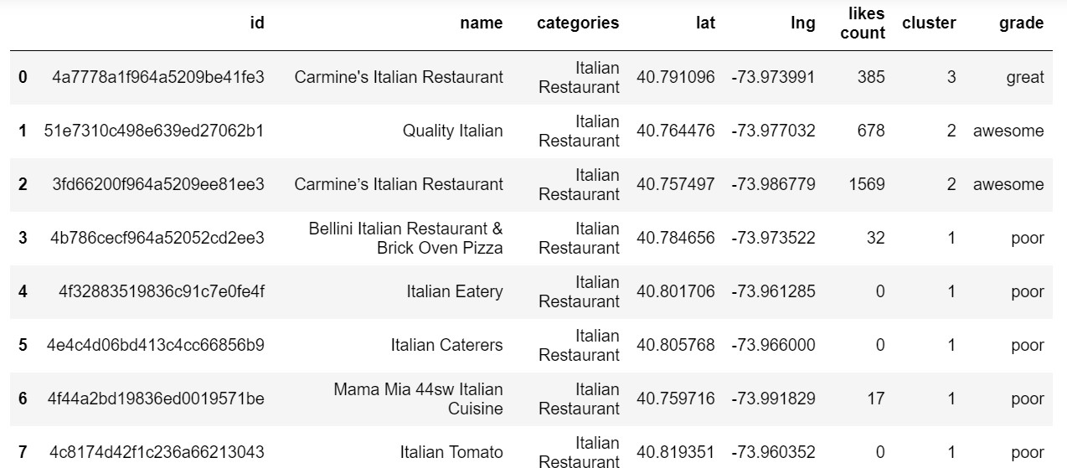
Run unsupervised learning K-means algorithm to cluster the venues. Here're the first 8 rows of venues dataset with cluster label

Slide 13
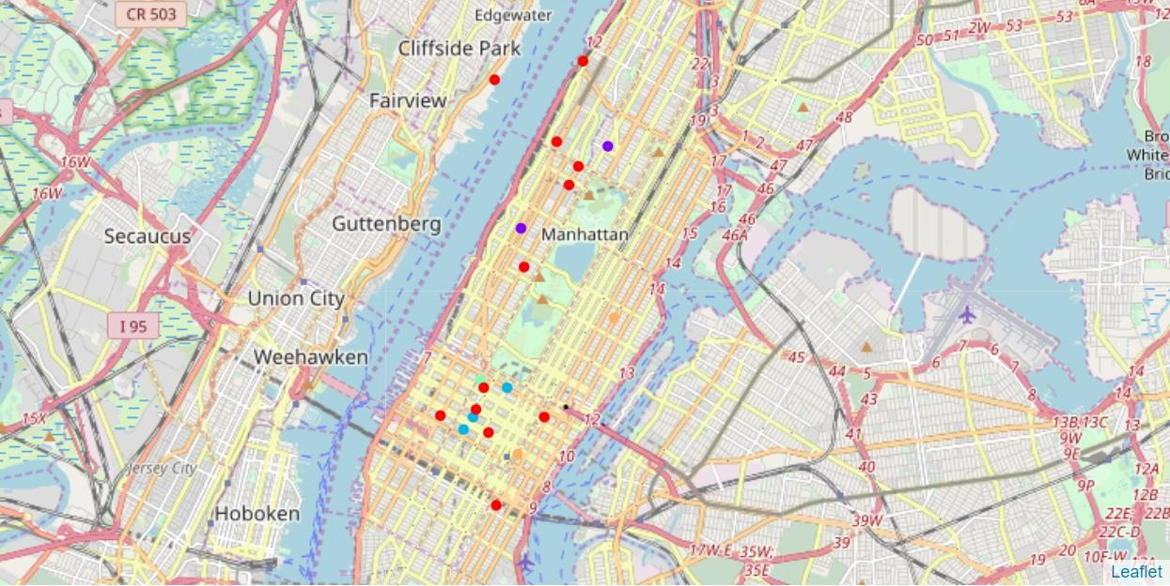
Visualize Clustering of venues

Slide 14
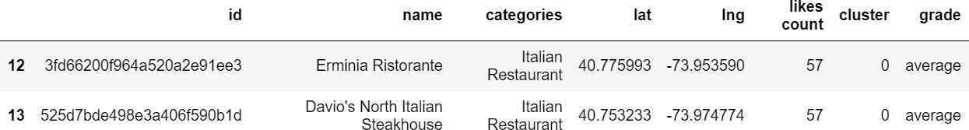
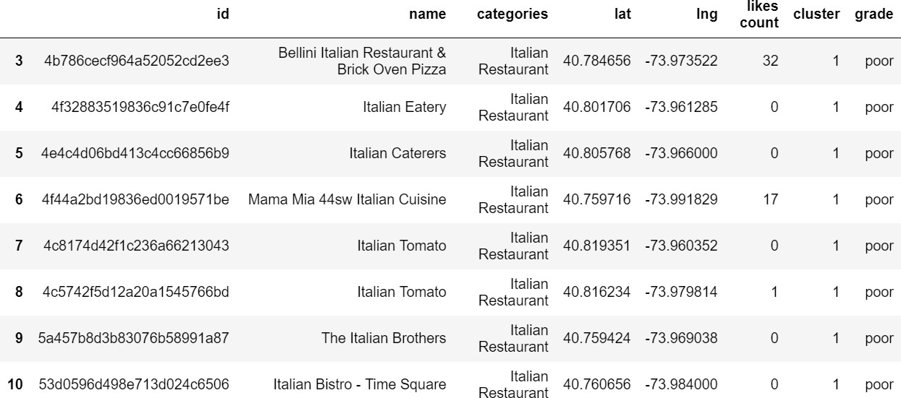
Examination of each cluster and find the discriminating likes count and grade that distinguish each cluster.
Cluster 0
Cluster 1 – First 8 rows

Slide 15
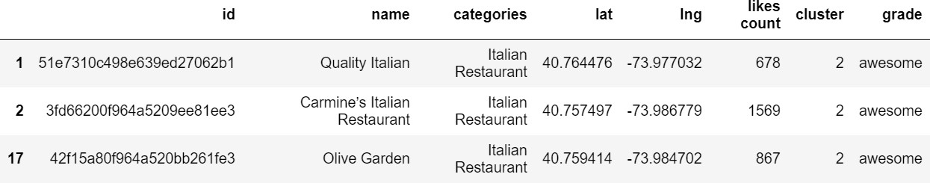
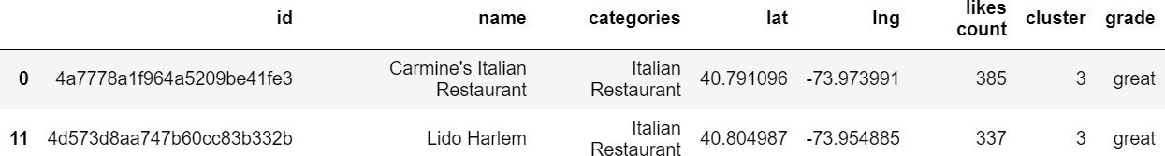
Examination of each cluster
Cluster 2 – Venues
Cluster 3 – Venues
Cluster 4 – Venues

Slide 16
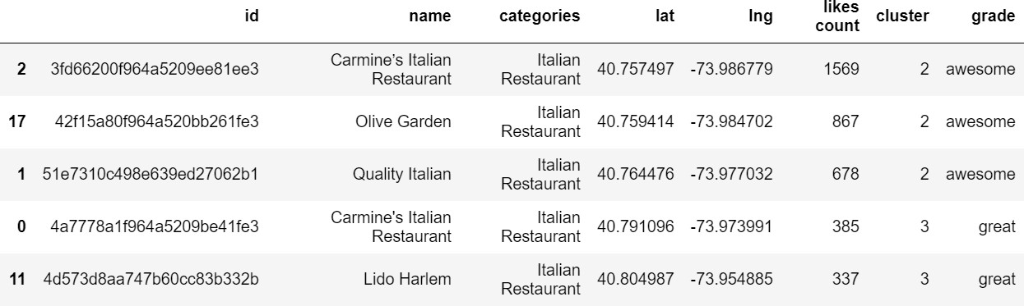
Sorted venues based on 'likes count' and created new dataframe with top 5 venues.
Here’s the dataframe.

Slide 17
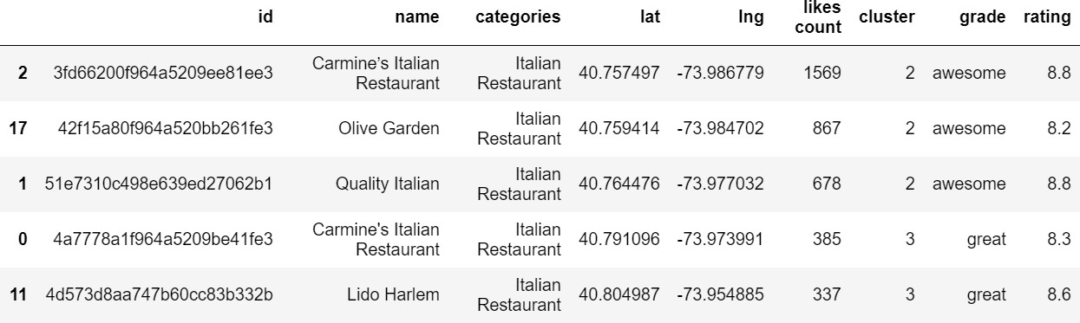
After adding ‘rating’ retrieved from Foursquare API to the venues dataset,
top 5 venues of the dataframe

Slide 18
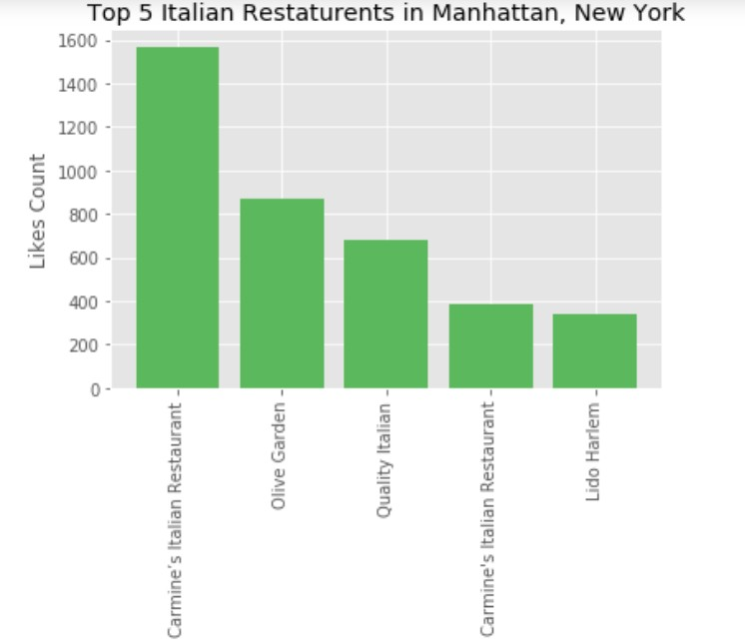
Created bar chart representing top 5 venues with their like count

Slide 19
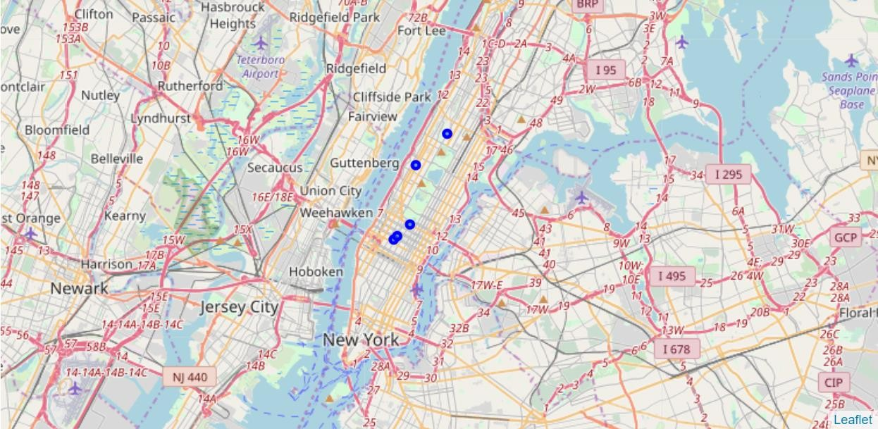
Created Manhattan, NY map with top 5 venues superimposed on top

Slide 20
Results
Cleaned dataset representing Italian restaurant venues have 20 rows. Categorizing venues based on ‘like count’ has resulted in the following break-down: 3 venues with ‘awesome’, 2 venues with ‘great’, 1 venue with ‘good’ and 2 venues with ‘average’ and the remaining 12 with ‘poor’ grades.
k-means clustering of venues has resulted in the following 5 clusters and grouping of venues by clustering matches with grade computed based on likes count:
Cluster label
Cluster 0
Cluster 1
Cluster 2
Cluster 3
Cluster 4
Venues
venues with ‘average’ grade 12 venues with ‘poor‘ grade
venues with ‘awesome‘ grade
2 venues with ‘great‘ grade
1 venue with ‘good‘ grade
It is noticed that all the top 5 venues ranked by likes count got more than 8 rating and the top ranked venue got the highest rating of 8.8

Slide 21
Discussion
Chosen the criteria of ‘likes count’ and ‘rating’ returned by Foursquare API for venues to group and decide which venues to be recommended to ABC Company for selecting the Italian restaurant. It is obvious that there may be other criteria based on other sources of data. This project scope is limited to using the data available through FoureSquare API.
This project demonstrated how we can leverage the data freely available on web and Foursquare API(though free version has limits on data points we can retrieve) to search and explore restaurant venues. We can adapt it to choose any other venue by changing the search query. This project is therefore, useful for anyone interested in selecting any other category of venue.

Slide 22
Conclusion
Based on two factors, namely ‘likes count’ and ‘rating’, Carmine's Italian Restaurant, Olive Garden and Quality Italian are ranked as the top 3 venues and presented as possible choices for consideration of the ABC Company, with the top 1 venue Carmine's Italian Restaurant as the preferred choice.
Anyone interested in finding any popular category of venue in any geographic location may also be interested in this project as we can adapt it choose any other venue by changing the search query.

